Slide 1
bit manipulation and Dynamic programming
Training Session 2

Slide 2
Goals for today
Some tips on approaching problems
Bit Manipulation (Syntax and Applications)
Dynamic Programming
Questions
Most important, we will discuss every concept using examples

Slide 3
General tips on approaching problems
Read the problem carefully, make sure you don’t miss any details, especially the constraints
Have a look at the sample test cases
Thinking of the right algorithm:
Try to break the problems into subproblems
Think of a brute force solution
Then try to optimize it using some programming techniques
​

Slide 4
Let’s look at an example
Problem link - Move Zeroes - LeetCode
Let’s go through it step by step

Slide 5
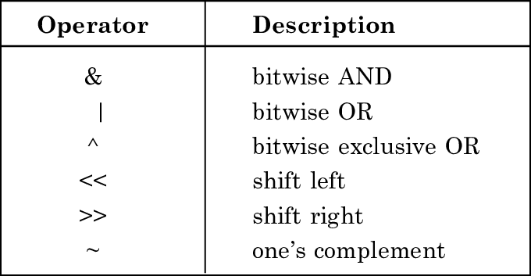
Bit manipulation
Bitwise Operators
Image taken from - link

Slide 6
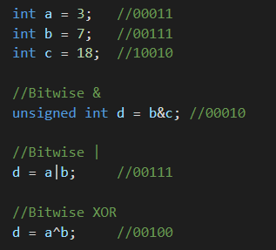
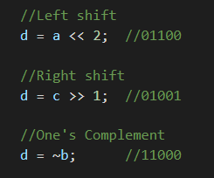
Syntax in c++ and java
The actual bits in an Integer depends on the Operating System and compiler, in most modern computers it is 32 bits.

Slide 7
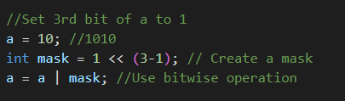
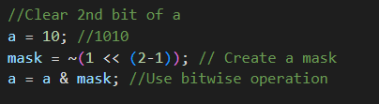
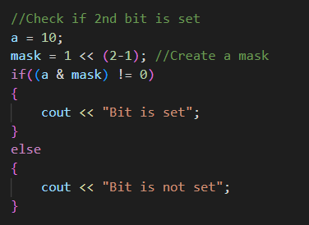
Applications
Set a Bit
Clear a bit
Check if a Bit is set or not

Slide 8
Let’s See some questions
Ques 1 - Find number of bits to change to convert a to b
Take XOR of a and b, the resulting number have bits set to 1 at positions where there were different bits in a and b
Just count the Number of bits in the resulting number (We will use a clever technique to compute number of set bits)
Ques 2 – Power set
Consider all integers from 0 to 2^n, where n is the number of elements
Each integer corresponds to a subset with elements corresponding to the set bits in it

Slide 9
Dynamic programming
Dynamic programming amounts to breaking down an optimization problem into simpler sub-problems, and storing the solution to each sub-problem so that each sub-problem is only solved once
Dynamic Programming (abbreviated as DP) is perhaps one of the most challenging problem-solving technique.
Involves lots of recursion and recurrence relations (we prefer iterative solutions)
The key skills that you must develop in order to master DP are the abilities to determine the problem states and to determine the relationships or transitions between current problems and their sub-problems
DP is primarily used to solve optimization problems and counting problems. If you encounter a problem that says, “minimize this” or “maximize that” or “count the ways to do that”, then there is a (high) chance that it is a DP problem

Slide 10
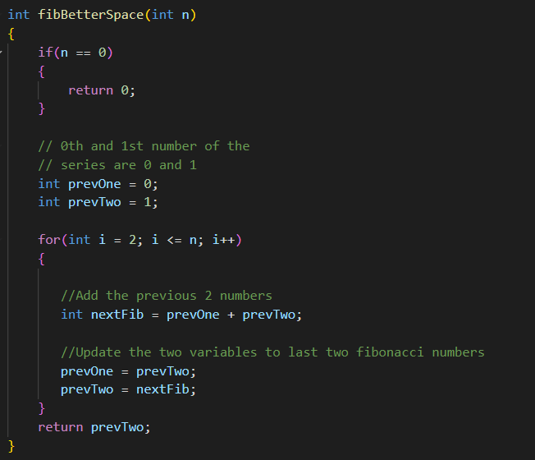
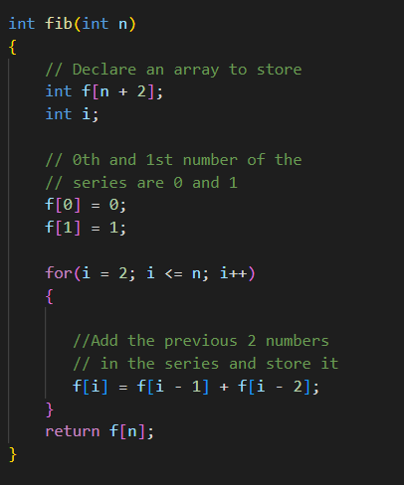
Example
Fibonacci Numbers

Slide 11
question
Climbing Stairs - LeetCode
Suppose that we are step k, it does not matter how we got there since there is no restriction on jumps
This suggests that the dimension/state of DP is the position, what I mean by this is that the array used to store information is 1 Dimensional, dp[i]
Now, let’s consider how can we reach here from previous states
Any Questions !!

Slide 12
Let’s see similar question
Climbing Stairs, now jumps of length 1, 2 and 3 are allowed
Problem link
Let’s discuss three different approaches
Recursion
Recursion with Memoisation
Iterative

Slide 13
Let’s Make it more interesting
Problem Link
Let’s discuss the general technique to tackle a dp question
Storage and meaning of dp array
The direction we go, we always go from smaller to larger problem
Iterate in that direction and solve
We have used both top-down and bottom-up approaches to implement dynamic programming in last couple of questions

Slide 14
Coin change problem
Problem link
Let’s consider the test case –> coins available: 1, 5, 7 required sum: 18
As you can notice greedy approach will not work
We will use Dynamic Programming, let’s try to break it into subproblems
In greedy approach, we intuitively assume some way is the right wat to solve the problem no matter what the sub problem is
In Dynamic Programming, we reconsider the optimal path at every subproblem
What about the time complexity in the recursive and recursion with memorization solution ?

Slide 15
SUMMARY
We have discussed Bit manipulation and Dynamic Programming.
In general, we use dynamic programming to solve the following type of problems :
Count something / number of ways
Minimize or Maximize certain value
YES / NO questions
There is a concept called dynamic programming using bit manipulation t optimise space, which was sort of a motivation behind these two topics being discussed together. We will review and discuss more dp problems, and techniques in future training sessions

Slide 16
THANK YOU for Coming!
Code and slides will be posted in the UMIEE discord

